Slide 1
Simulating Wireless Sensor Networks

Slide 2
Most tools focus only on the communications problem and do not model the power and sensing aspects that significantly impact network design.
Sensors for military applications will usually need to be small and have short transmission ranges to reduce the probability of detection.
This constrains CPU speed, memory size, RF bandwith, and battery size.
During periods of low activity, the network may need to enter a dormant state in which many nodes got to sleep to conserve energy.
Since sensors are susceptible to failure and destruction, redundancy is critical as is the networks ability to adapt to topology changes and make the best use of the remaining sensors.

Slide 3
Thus, in contrast to traditional internet and ad-hoc protocols, sensor network protocols need to sustain large numbers of nodes at high densities.
Since the longevity of the network relies on the finite energy source of sensor batteries, it is imperative that any algorithms or protocols used for sensor networks are carefully studied for their efficiency in power consumption.
It is assumed that that the data rate is a major factor contributing to the transceiver power consumption where higher data rate will lead to higher power consumption. However, a higher data rate takes less time depleting less battery capacity.
In this context it is perceived that lightweight, application specific protocols are more desirable than those found in a legacy protocol stack.
As sensor networks evolve, their addressing requirements change, thus it is perceived that the use of IP is not required and the packet structure is likely to differ.

Slide 4
The MAC and routing layers are also expected to be lightweight, with the possibility of being fused together.
These decisions depend on which requirements have priority for that specific network application including; densities, latencies, fault tolerance, and lifespan.
Applications required in a sensor network may change during its lifespan, and since it is impossible to preinstall all possible applications, a mechanism that allows for the dynamic management of sensor nodes may be needed.

Slide 5
Since sensor nodes have small antenna heights, when placed on the ground they exhibit l/r^4 wireless link path loss. The high energy costs associated with this type of wireless transmission coupled with the reducing cost of processing, have led to the adoption of the distributed computing viewpoint for wireless sensor networks.
Instead of simply sending the raw data to a gateway node, the sensors perform computation or decision making within the network. This is perceived to reduce communication, thus prolonging the network lifespan.
In some cases, distributed computing utilizing localized algorithms is more suitable and more energy efficient than traditional centralized algorithms.

Slide 6
The algorithms in the network and sensor stack should control changes in mode of the power consumers.
TDMA has been chosen for transmission and reception in many cases, as sensor nodes do not have to be in receive mode during the time slots where none of its neighbors is scheduled to transmit. This allows the nodes to put the CPU and radio to sleep during idle slots to conserve battery capacity.
DSR (Dynamic Source Routing) has been successfully used with sensors employing CBR (Constant Bit Rate) agents that generate packets at regular intervals.
The sensor channel is difficult to model, as these complex models are not yet well defined an understood. To accurately model sensor data, simulation should become emulation with virtual networks interacting with real sensor nodes.

Slide 7
In studying the performance or a wireless sensor network, you must take into consideration the deployment scenario which includes; topology, radio ranges, trajectory of targets and event traffic, and trajectories of user nodes and query traffic. All of these affect design trade-offs, and therefore any algorithm or protocol chosen should be evaluated under diverse deployment scenarios.

Slide 8
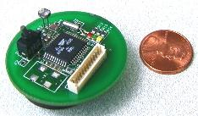
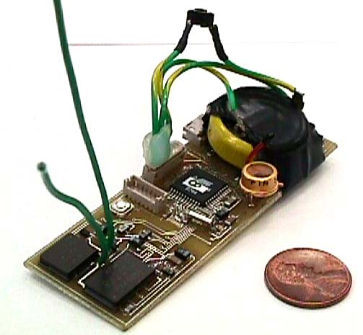
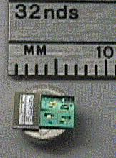
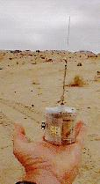
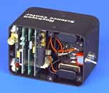
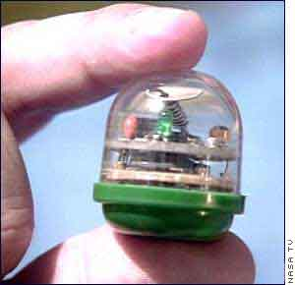
Modern Sensor Nodes
UC Berkeley: COTS Dust
UC Berkeley: Smart Dust
UC Berkeley: COTS Dust
UCLA: WINS
Rockwell: WINS
JPL: Sensor Webs

Slide 9
First Generation Node Hardware
1Kbps - 1Mbps,
3-100 Meters,
Lossy Transmissions
128KB-1MB
Limited Storage
Transceiver
Memory
Embedded
Processor
8-bit, 10 MHz
Slow Computations
Sensors
66% of Total Cost
Requires Supervision
Battery
Limited Lifetime

